Slide 1
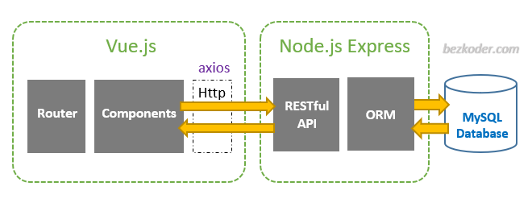
Project Model

Slide 2
frontend - VUE
Assets: Logs, images, files etc to use thos
Components: Component files
API: API’s
Router: Router files
Utils: Any custom functions that can be reused further
Views: Route pages (Home, About etc)
App.vue: Vue app
Main.js : Main Script

Slide 3
Backend - VUE
Controllers: All API’s (get, get All, put, update, delete etc)
Models: Backend Schema’s (Db, tables)
Public: Any public content
Routes: Routing API calls
Utils: Any custom functions that can be reused further

